Slide 1
Paper reading: Pseudo lidar for 3D object detection
Houpu Yao
2019.10.25
Notes:
Background
Algorithm: Pseudo lidar (PL)
Algorithm: Pseudo lidar++ (PL++)
Discussions

Slide 2
Background
What is pseudo lidar?
Extract the geometry information captured by camera sensors and transform it into point clouds representation
Why pseudo lidar?
Lidar: Cost too high, but accurate 3D bounding box detection
Camera: lower cost, but not good at 3d bounding box detection
Pseudo lidar: much lower cost than Lidar, better performance than camera
Notes:
First, local patches on 2D images are only coherent physically if they are entirely contained in a single object.
Second, objects that occur at multiple depths project to different scales in the depth map.

Slide 3
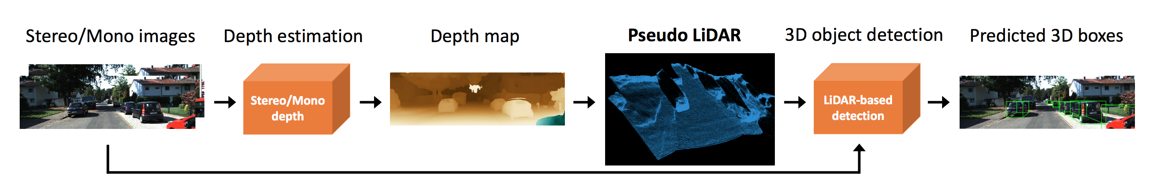
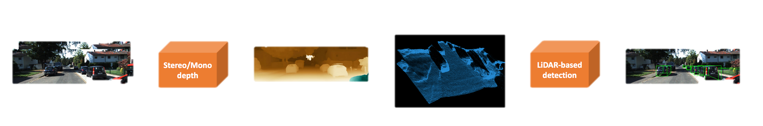
Object detection with PL
Wang, Yan, et al. “ Pseudo-lidar from visual depth estimation: Bridging the gap in 3d object detection for autonomous driving." Proceedings of the IEEE Conference on Computer Vision and Pattern Recognition. 2019.
Disparity map
Geometry based
Deep learning based
VAOD
Frustum PointNet
PointPillars
….
Geometric transformations
Notes:
The whole pipeline is trained with kitti dataset. Since the maximum depth in the dataset is 70m, that is the upper limit.

Slide 4
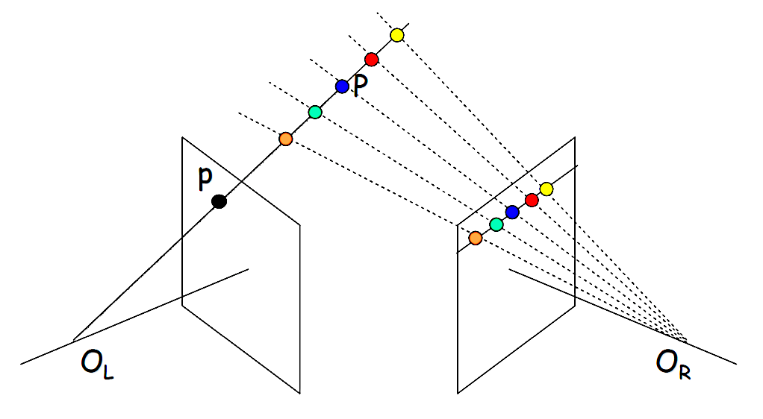
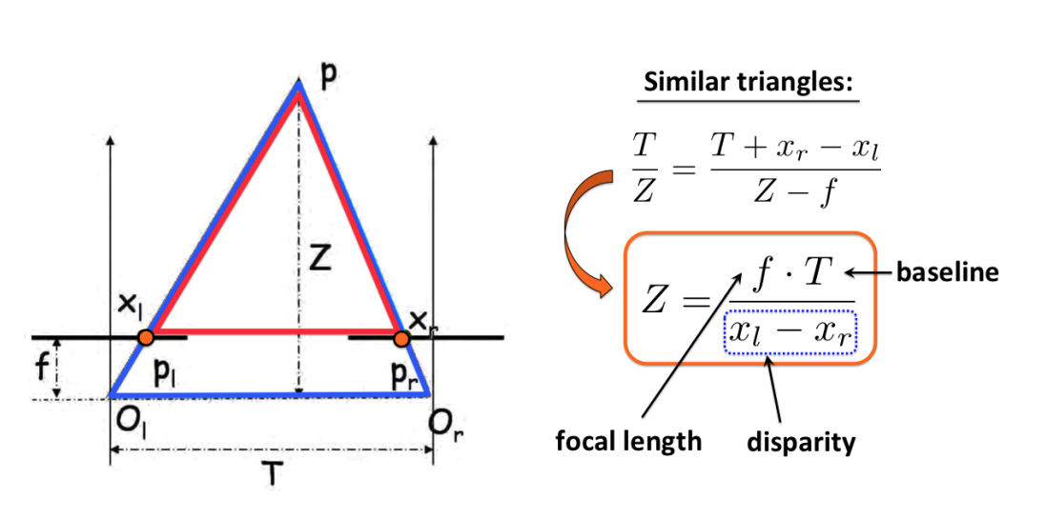
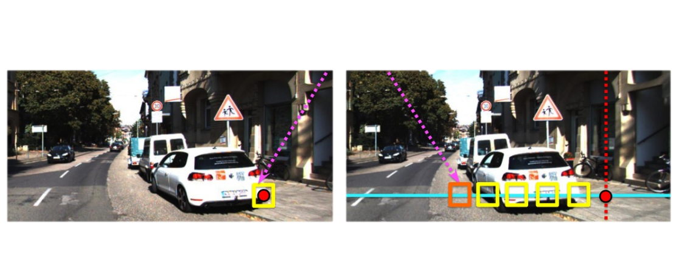


Object detection with PL
Disparity estimation – with stereo geometry based approach
Stereo camera model:
$$x_{l}$$
http://www.cs.toronto.edu/~fidler/teaching/2015/CSC420.html
$O_{l}pO_{r}$ plane
How similar?
Template matching for correspondence:
Error in rectification
Error in template matching
http://www.cs.toronto.edu/~fidler/teaching/2015/CSC420.html
Left image
Right image
http://www.cs.toronto.edu/~fidler/teaching/2015/CSC420.html
Notes:
Question: how to find Epipolar Lines, with fundamental matrix
So far, each left image patch has been matched independently along the right epipolar line. This can lead to errors. We would like to enforce some consistency among matches in the same row (scanline).

Slide 5
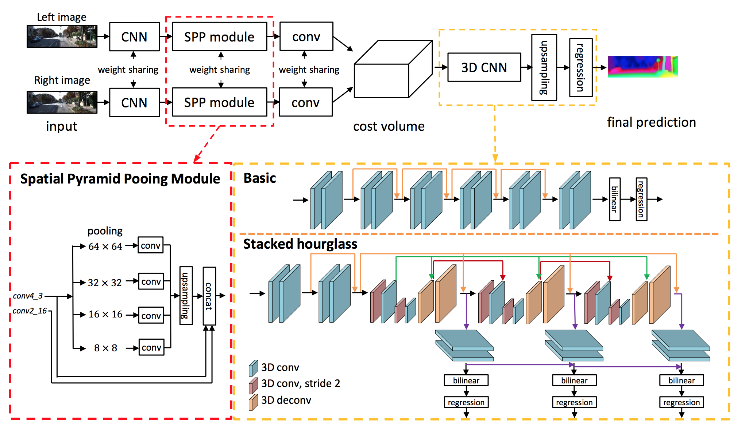
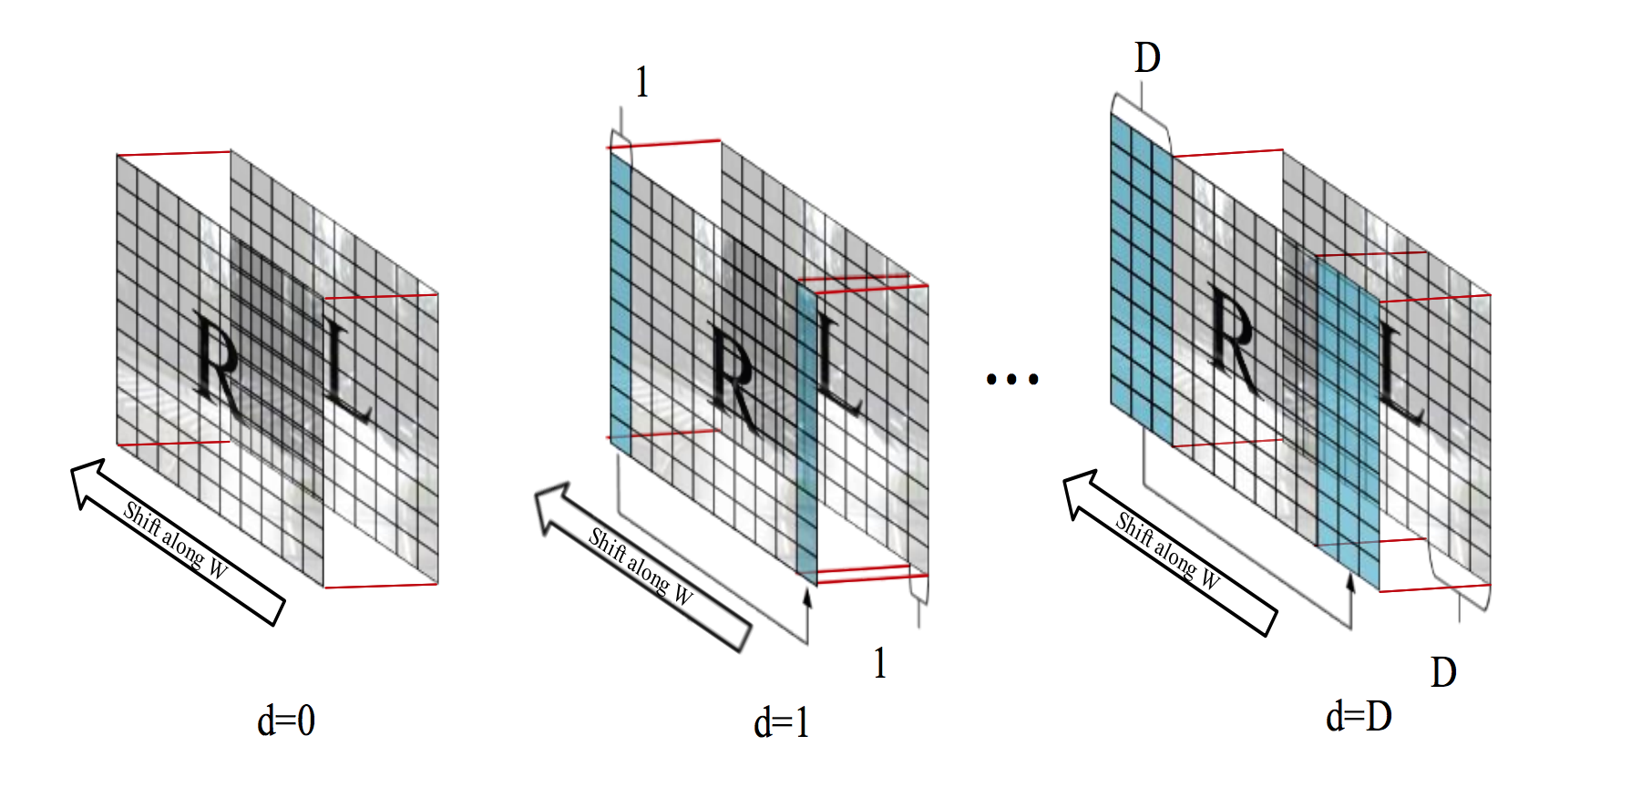

Object detection with PL
disparity estimation – deep learning based approach (PSM-Net)
Overall network architecture:
Construction of cost volume:
Shifting the image by one pixel alone the 3rd dim
Yu, Lidong, et al. "Deep stereo matching with explicit cost aggregation sub-architecture." AAAI. 2018.
$$C\left[x,y,d,:\right]= L\left(x,y,:\right)−R\left(x−d,y,:\right)$$
Chang, Jia-Ren, and Yong-Sheng Chen. "Pyramid stereo matching network." Proceedings of the IEEE Conference on Computer Vision and Pattern Recognition. 2018.
Disparity level max: 192
Notes:
However, current architectures rely on patch-based Siamese networks, lacking the means to exploit context information for finding correspondence in ill posed regions.
In a typical labeling approach, the input data is used to construct a three-dimensional cost volume, which stores the costs for choosing a label l (i.e. disparities in stereo) at image coordinates x and y. For stereo, these costs are given by pixel-wise correlation (e.g. absolute differences of the intensities) between corresponding pixels.
a three-dimensional cost volume is constructed by computing the per-pixel matching costs at all possible disparity levels.
Therefore, doing a so�-max gives a probability distribution over possible values of disparity. But they don't train this with a classification loss: because some mis-classifications are worse than others ! (d=5 instead of 4 is better than d=25 instead of 4)

Slide 6
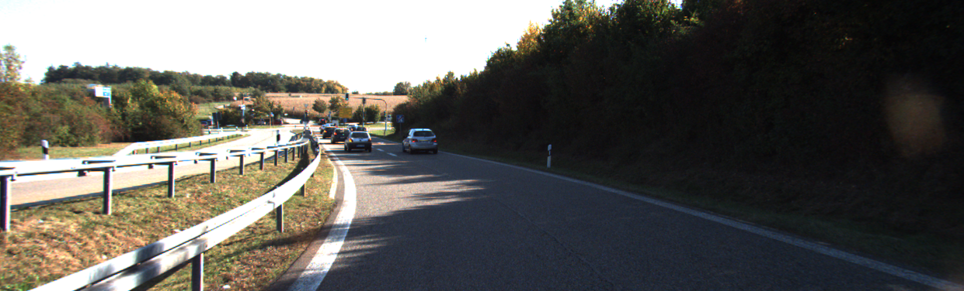
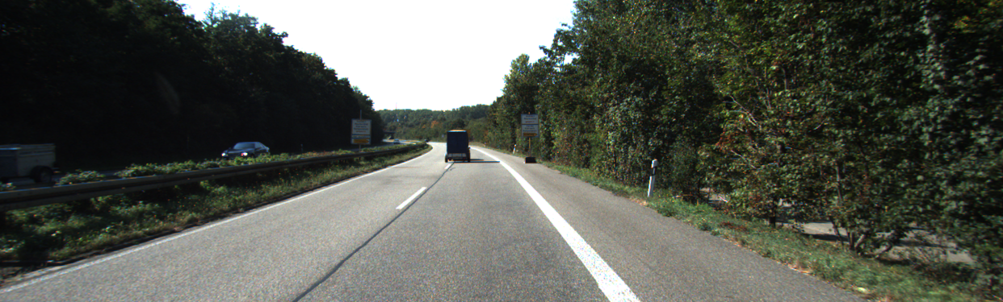
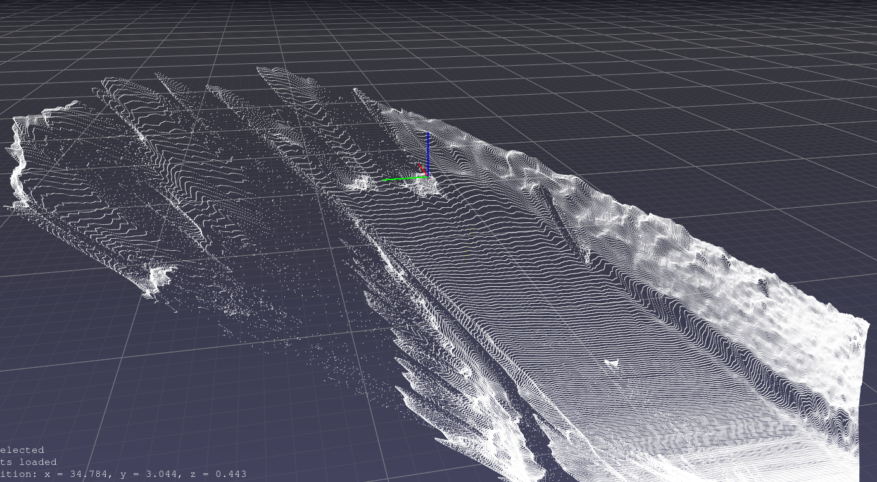
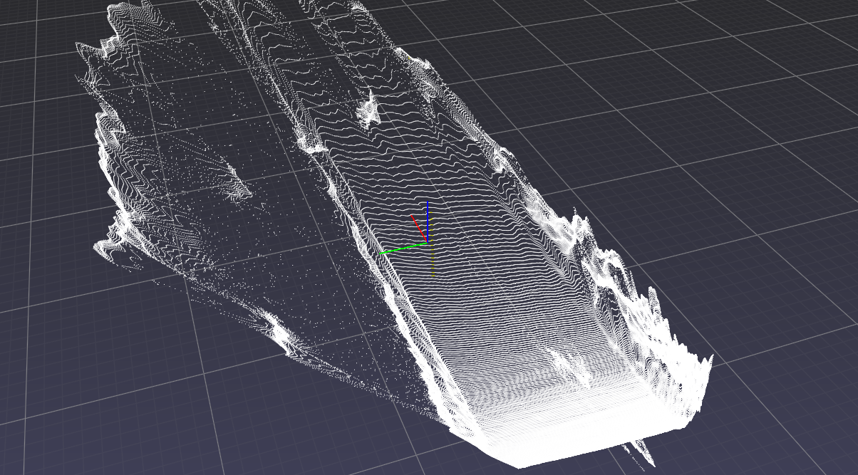
Qualitative results of pseudo lidar
Distance: 35m
Distance: 40m
Notes:
1. Looks good in general
2. distortion

Slide 7
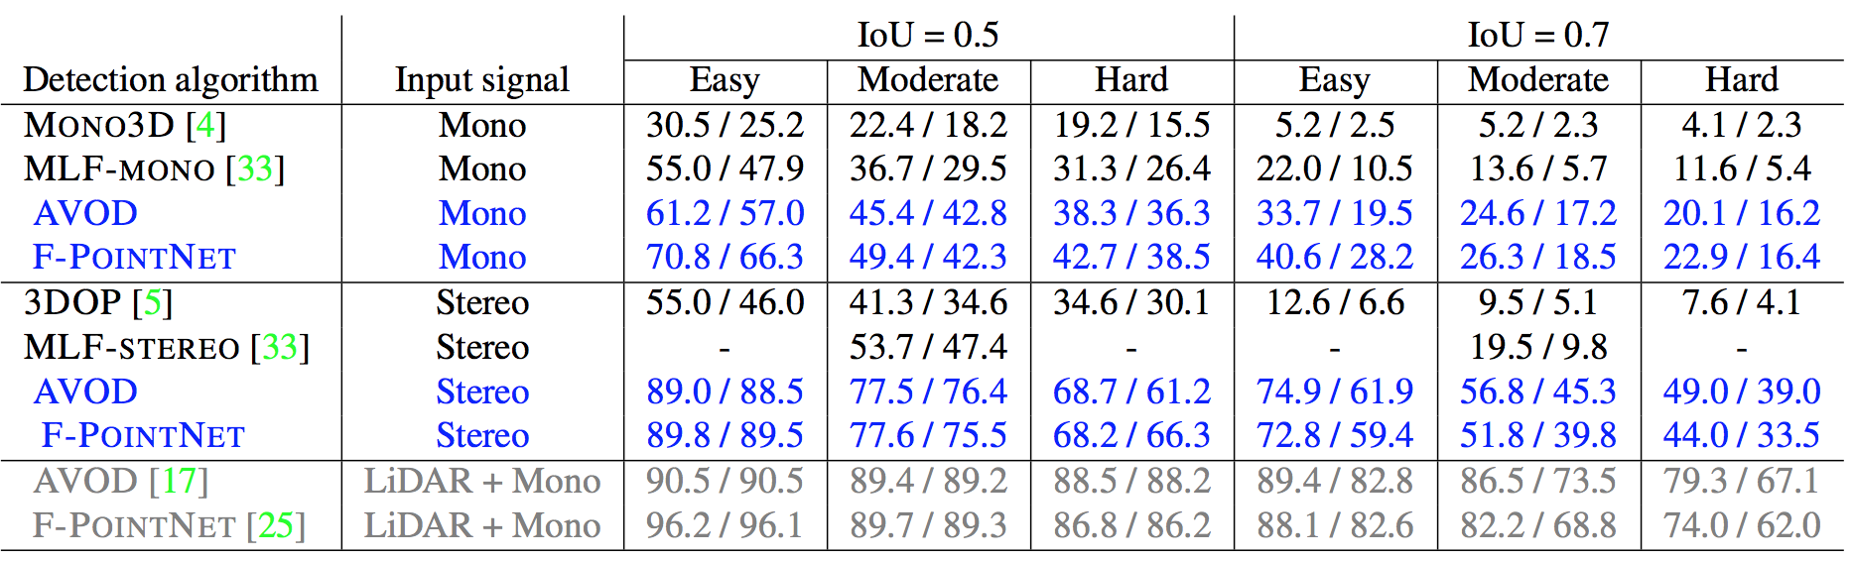
Quantitative results of pseudo lidar
Precision in object detection:
3D object detection results on the KITTI validation set
AP_BEV / AP_3D (in %) of the car category
Rows in blue denotes result from pseudo lidar
Observations:
1. Pseudo lidar increased object detection accuracy by huge margin
2: object detection based on single image is performing much worse than stereo
3: object detection with pseudo lidar is still not comparable to real lidar performance
Notes:
Other ways to estimate depth image from single image. These approaches also work in some extend, however, their performance is relatively low.
Lidar: 64 beams from KITTI
MLF CVPR2018 previous SOTA

Slide 8
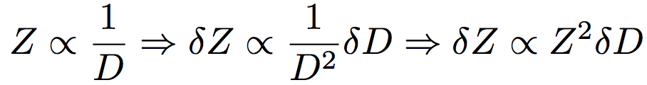
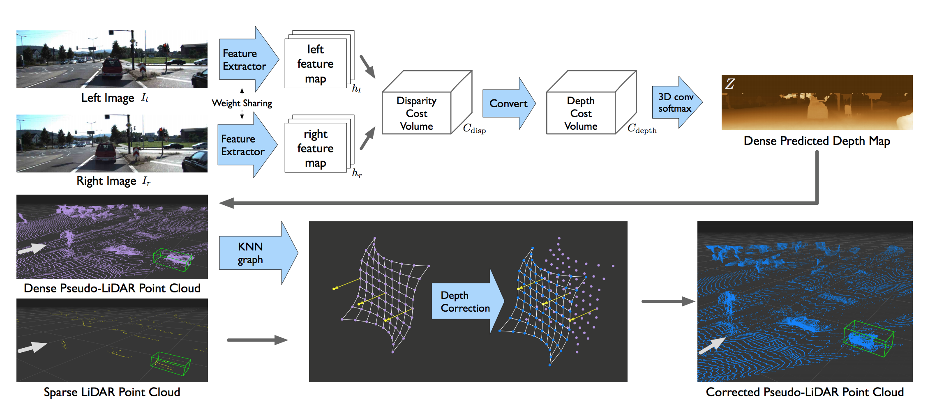
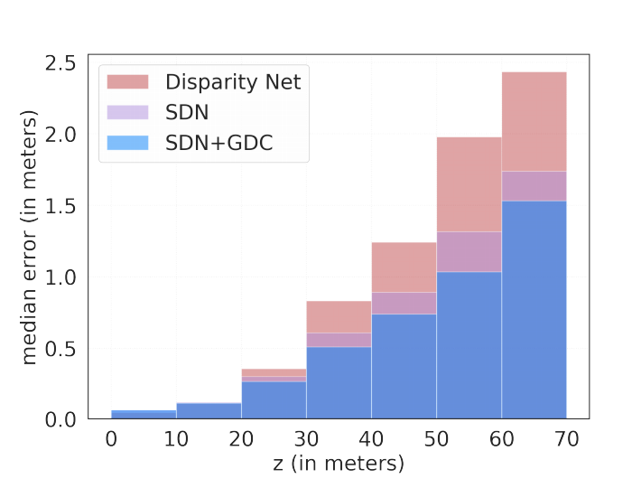
Pseudo Lidar ++
Improvements:
Directly estimate depth map
Correction with sparse lidar point cloud
Intuition on the high error rate of far away object:
1. Given disparity error, the error in depth increases quadratically with depth
2. Similar to image pixels, the disparity (depth) estimation is quantized
Network architecture:
Comparison of depth estimation error
You, Yurong, et al. "Pseudo-LiDAR++: Accurate Depth for 3D Object Detection in Autonomous Driving." arXiv preprint arXiv:1906.06310 (2019)
Notes:
graph-based depth correction (GDC)
Code not released yet

Slide 9
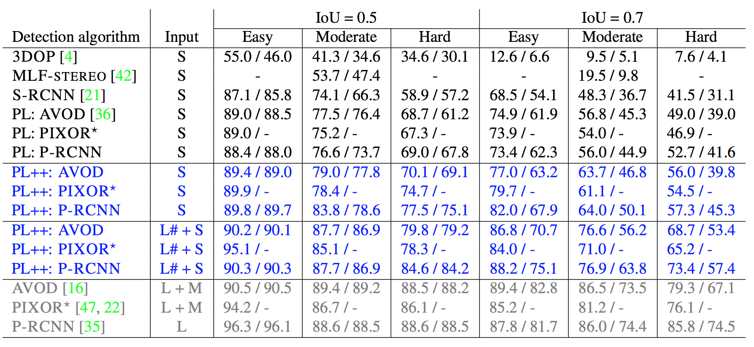
Quantitative results of pseudo lidar ++
Precision in object detection:
Rows in blue denotes result from pseudo lidar++
Input source: M(Mono), S (Stereo), L# (4-beam lidar), L(64-beam lidar)
Notes:
4 beams lidar + 2 camera: $0.8k
64 beams lidar: $75k
Current best: 79.79%
3D object detection results on KITTI validation. We report APBEV / AP3D (in %) of the car category, corresponding to average precision of the bird’s-eye view and 3D object detection. We arrange methods according to the input signals: M for monocular images, S for stereo images, L for 64-beam LiDAR, and L# for sparse 4-beam LiDAR. PL stands for PSEUDO-LIDAR. Our PSEUDO-LIDAR ++ (PL++) with enhanced depth estimation — SDN and GDC— are in blue. Methods with 64-beam LiDAR are in gray. Best viewed in color.

Slide 10
Take away points
Three steps of 3D detection based on pseudo lidar:
Estimate disparity with neural network
Obtain pseudo lidar point cloud from disparity map based on geometry relationship
Perform 3D object detection
Advantages:
The cost is much lower than a real Lidar
Achieved state-of-the-art performance in image-based 3D bounding box detection
Existing work on disparity (depth) estimation and 3D object detection can be directly used
Drawbacks:
Whole workflow takes ~1s
Low accuracy far away objects

Slide 11
Summary
Current limitations
Future directions
Lower resolution
Distortion for far away objects
Use much higher resolution image ( current 0.4M pixel)
Incorporate recent depth estimation models: Anynet Madnet
Notes:
Training data can be easily obtained from simulators!!
Associate color to the point cloud
E.g. green points usually corresponds to trees
Use narrow forward camera
Larger set of deeper depth image

Slide 12
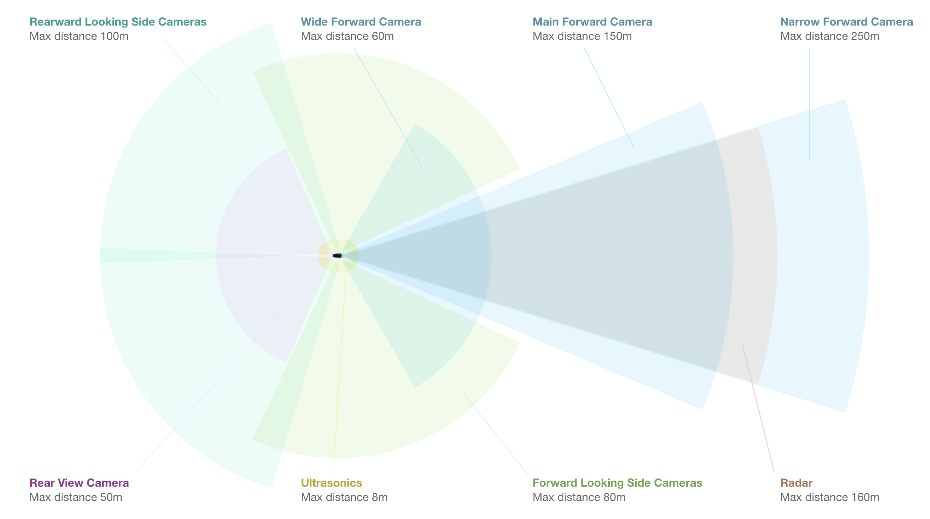
Summary
Velodyne VLS-128
2.4M points per second, 300m, 10Hz
That is 667 points per angle @ 10 hz
Tesla narrow forward camera
1280×960, 250m, 30hz, 35 FOV
That is 35k points per angle @ 30hz

Slide 13
Future directions, cont’d
Combination with lane detection:
camera input
lane detection
focus on the far end of the lane
images
depth estimation
3D bbox detection
pseudo point cloud generation
Filtering
(project to 2D)
segmentation
Notes:
Alpha puck

Slide 14
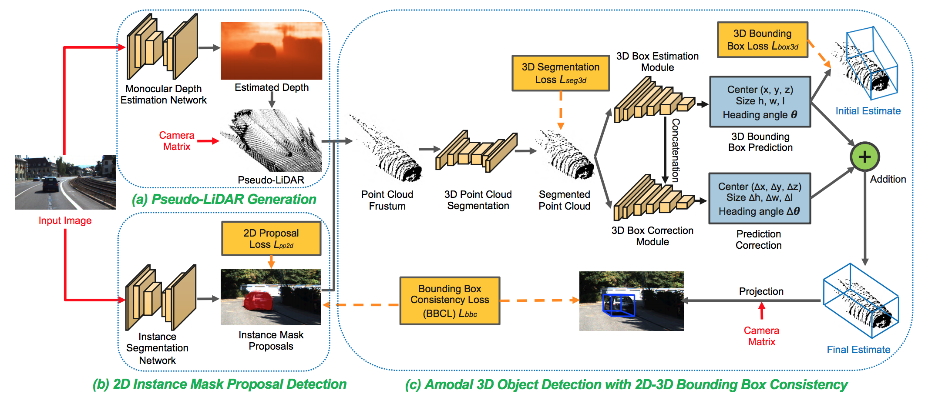
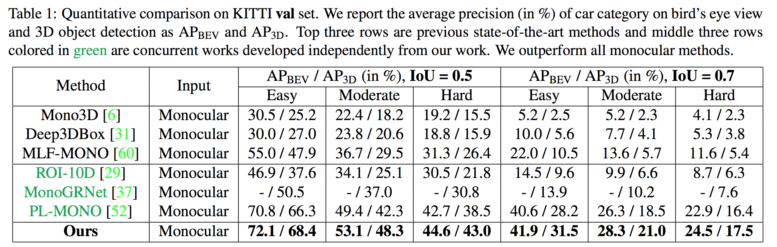
Weng, Xinshuo, and Kris Kitani. "Monocular 3D Object Detection with Pseudo-LiDAR Point Cloud." arXiv preprint arXiv:1903.09847 (2019).

Slide 15
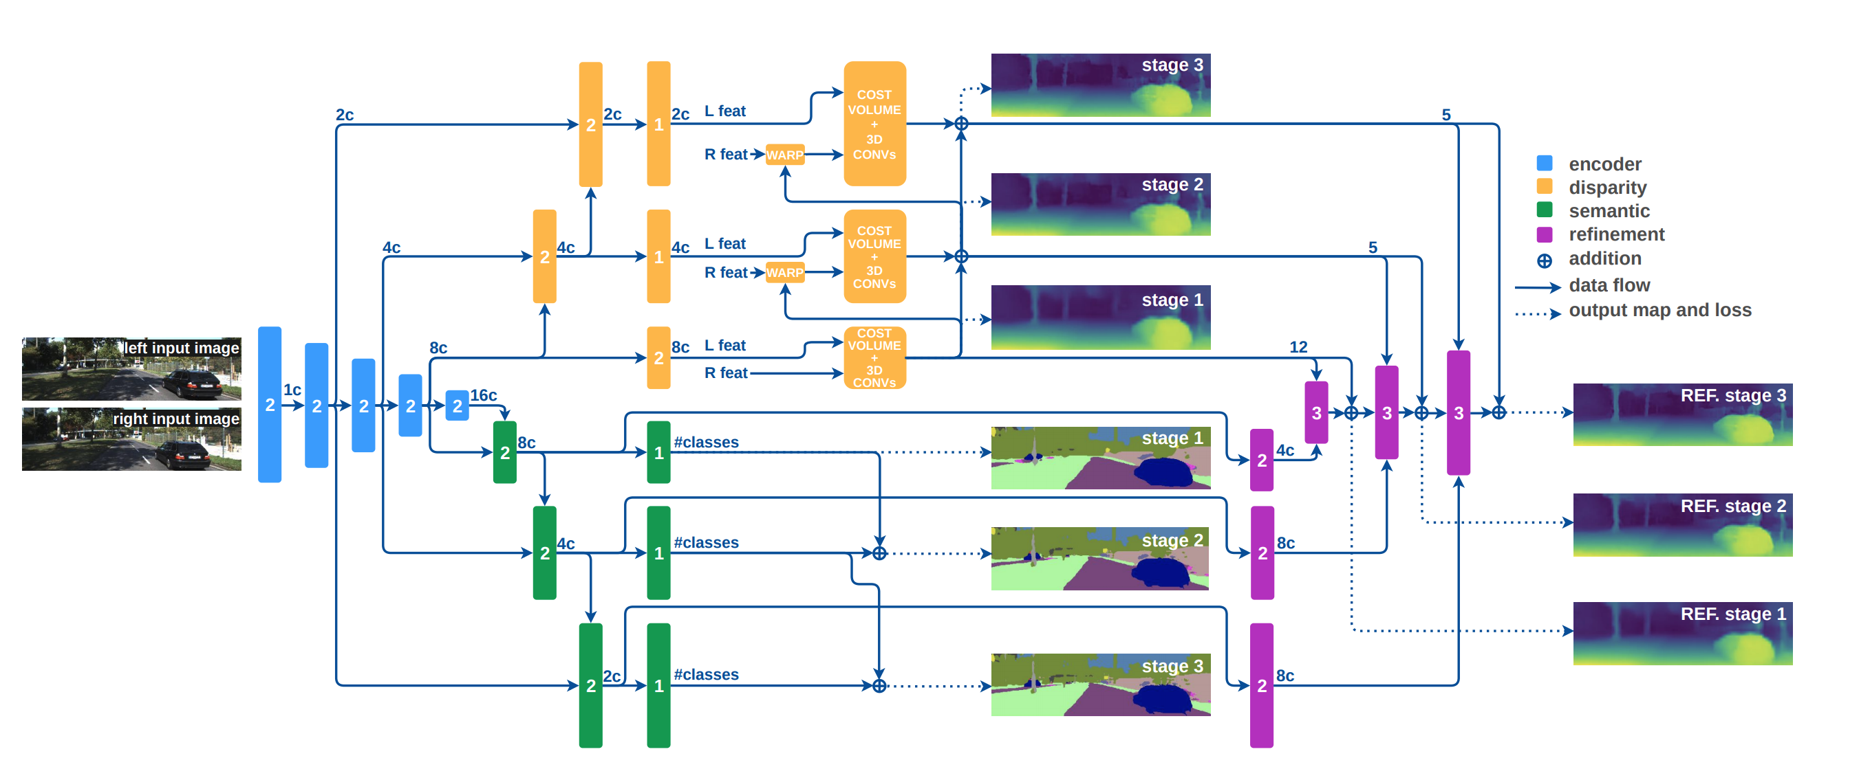
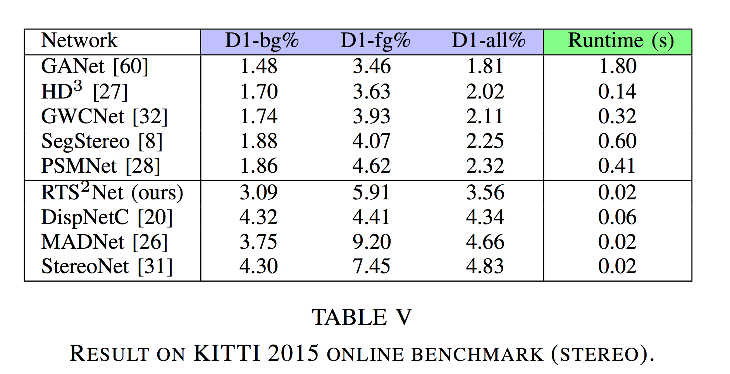
Real-Time Semantic Stereo Matching
Notes:
Both segmentation and disparity are fully computed only at the lowest resolution and progressively refined through the higher resolution residual stages

Slide 16
Yang, Guorun, et al. "DrivingStereo: A Large-Scale Dataset for Stereo Matching in Autonomous Driving Scenarios." Proceedings of the IEEE Conference on Computer Vision and Pattern Recognition. 2019.

